Slide 1
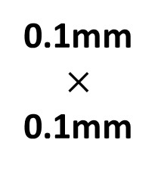
Electron Beam Lithography and Sputtering
3mmx1.5mm cut samples, 100nm PMMA coated
I will provide the Raith pattern files for EBL, followed by sputtering and lift-off, may be different patterns for the 30 patterns, 50-250 nm
I will provide the sputtering targets: MgO, CoFeB, Ta, Pt, Cr, PMN-PT, FeGa etc., thicknesses vary 0.8 nm – 100 nm
3 mm
0.5 mm
(1,1)
1.5 mm
0.1mm $×$
0.1mm
(3,10)
0.5 mm
0.5 mm
0.5 mm

